Slide 1
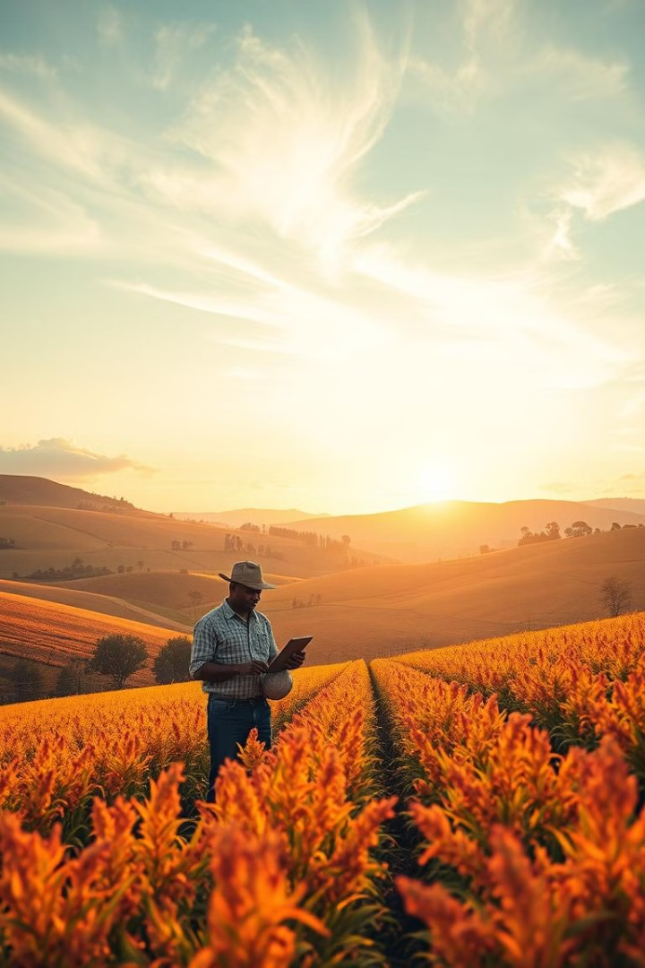
Revolutionizing Agriculture: A New Era for Farmers
Welcome to our innovative agricultural website designed to empower farmers with the latest tools and information to optimize their operations and maximize their success.
by AgriTechHub

Slide 2
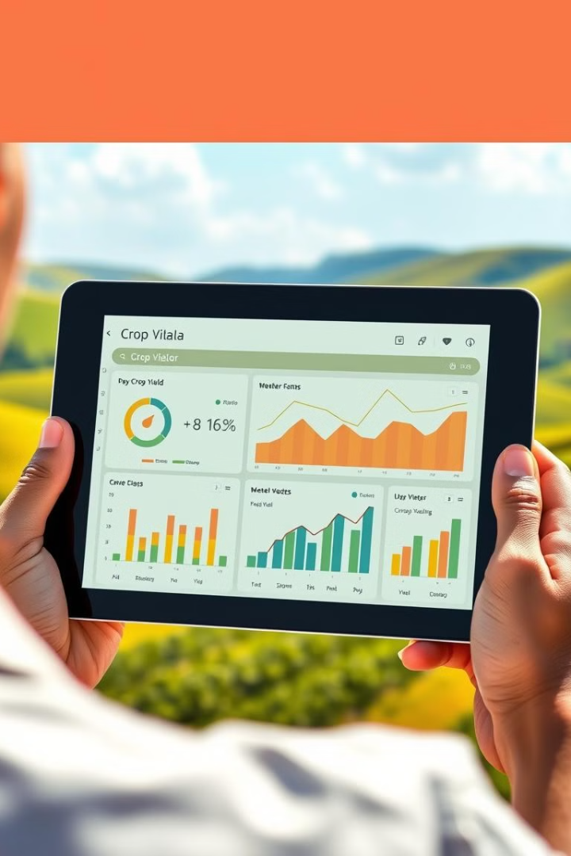
Crop Disease Management
System
1
Early detection
Utilise our AI-powered image recognition tool to identify
disease at their earliest stages, minimizing damage.
2
Treating Recommendations
Receive customized treatment recommendations based on identified disease and your specific growing conditions.
3
Integrated Pest Management
Adopt sustainable pest management strategies that reduce the risk of disease outbreaks and environmental impacts.

Slide 3
Weather Forecasting
Accurate Predictions
Targeted Alerts
Planning Advantage
Our system uses advanced algorithms to provide reliable weather forecasts.
Receive timely alerts on critical weather events that might affect your crops.
Optimize planting, irrigation, and harvesting schedules based on accurate weather data.

Slide 4

News for Farmers
1
Market Trends
2
Industry Updates
Stay updated on global and local market trends for agricultural commodities.
Learn about the latest research, technologies, and best practices in agriculture.
3
Policy Developments
4
Expert Insights
Stay informed about changes in agricultural policies and regulations.
Access articles and interviews with leading experts in the agricultural sector.

Slide 5

Marketplace for Farmers to Trade
Buy & Sell
Transparent Pricing
Connect with other farmers to buy and sell agricultural products directly.
View real-time pricing information for various agricultural products.
Secure Transactions
Community Building
Our platform offers secure payment options and transaction tracking.
Foster connections and collaborations among farmers across the region.

Slide 6
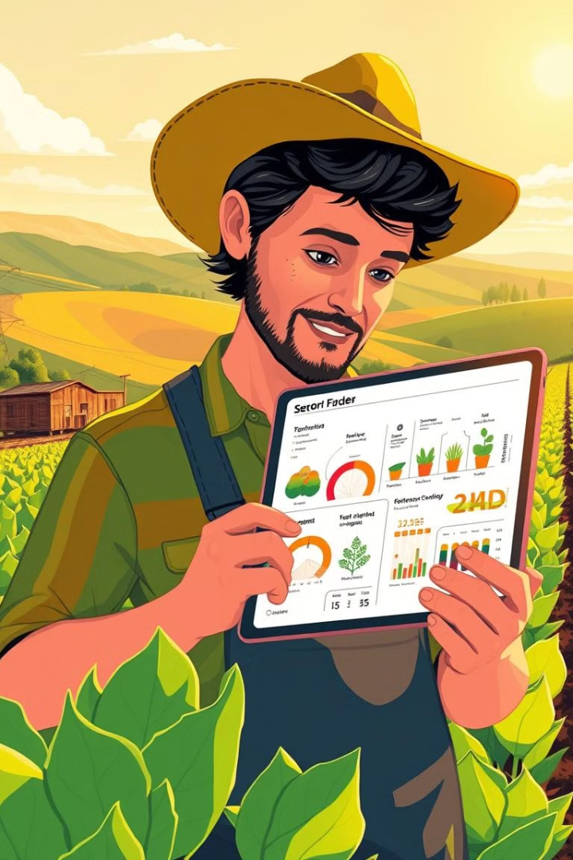



Agronomy Support
Crop Nutrition
Receive personalized recommendations for fertilizers and soil amendments.
Pest & Disease Management
Get expert advice on identifying and controlling pests and diseases.
Water Management
Optimize irrigation schedules and techniques based on crop needs and weather conditions.

Slide 7

Carbon Footprint Tracker
Calculate emissions
Track emissions from farming activities.
Identify opportunities
Identify areas for improvement to reduce carbon footprint.
Environmental sustainability
Contribute to a more sustainable and environmentally friendly agricultural sector.

Slide 8





Chatbot for Farmers
24/7 Support
Time Savings
Personalized Advice
Easy Access
Get instant answers to common agricultural questions at any time.
Reduce research time and get quick answers to urgent needs.
Receive customized recommendations based on your specific farming situation.
Interact with the chatbot through our website or mobile app.

Slide 9
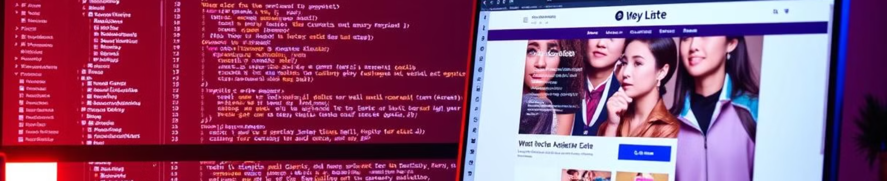
Technologies Used
1
APIs
2
Machine Learning
3
Django
Integration with various data sources, including weather, market data, and agricultural research.
Predictive analytics for weather forecasting, crop yield estimations, and personalized recommendations.
Powerful framework for building a scalable and secure web application.

Slide 10

Conclusion and Key Takeaways
Our website provides cost-effective services for both farmers and experts. Farmers can consult experts for ₹150 to ₹300 per session, with experts earning ₹75 to ₹150 per consultation. Experts pay an annual registration fee of ₹1,500 to ₹3,000, and farmers can access storage services for ₹120 to ₹240 per year. This pricing ensures affordability and value for all users.Our agricultural website offers a comprehensive suite of tools and services to empower farmers. By leveraging technology, we aim to improve farming efficiency, enhance profitability, and promote sustainable practices.

